Slide 1
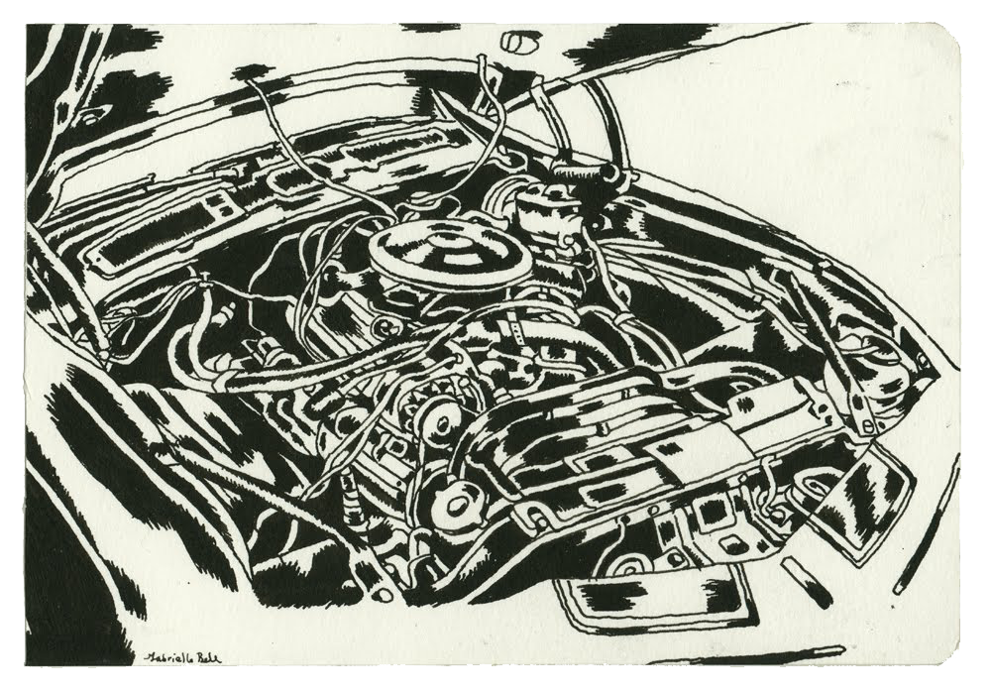
What’s under the hood? Genomic differences powering variation in primary fermentation
Simon Schmidt
Notes:
The driving force in the transformation from grape to wine is yeast.
There is significant diversity in the group of yeast that make wine.
But how much and to what extent?
On what basis do we choose yeast for a particular job?

Slide 2
Strain choice and the power of marketing
Strain AwesomeX is generally recommended for red wine production, particularly varietal wines such as Shiraz/Syrah, Cabernet, Merlot and Pinot Noir.
In red grape juices, Strain AwesomeX produces blackberry, plum and raisin aromas.
Strain AwesomeY is recommended for its ability to develop the quintessence of the Chardonnay grape variety.
Strain AwesomeY produces wines with mouth feel whilst developing the most typical flavours of the variety: citrus flavours (lemon and grapefruit) as well as tropical fruit flavours.

Slide 3
Yeast genetic diversity
Anecdotal understanding of wine yeast relationships
Clouded history of strain “sharing”
re-badging / re-selling
Limited data about historical isolates
Borneman et al (2012) FEMS Yeast Research 12(1):88-96
Notes:
A similar tree is presented by Liti et al 2009 but did not include as many wine strains
Representation of our current limited understanding of wine yeast diversity.
These relationships have been defined using whole genome sequences of yeast.
This particular tree draws relationships between yeast used in a wide variety of different industries and for different purposes.
There are more than 200 commercial wine yeast available to winemakers.
While we have whole genome sequences available for a few yeast, even a few wine yeast, we don’t yet have a good understanding of the extent of yeast diversity and the relationships between them.
How can you choose which is the most appropriate?

Slide 4
Diversity of wine yeast characteristics
Responses to low pH and SO₂
Slow start to fermentation
Oxygen limitation during fermentation
Sluggish and stuck ferments
Notes:
Discuss through the prism of fermentation performance
Diversity also exists, of course, in the flavour and aroma characters that individual yeast impart on the wine.

Slide 5
Impact of pH and SO2
is yeast strain dependant

Slide 6
Long lag due to reduced viability following inoculation
Effect on cell viability
Viability at
Inoculation

Slide 7
Moderate conditions can also affect sensitive strains
The effect of incremental changes in pH and SO2 on
fermentation of Chardonnay juice by 71B
Total sugar (g/L)
Fermentation time (days)

Slide 8
Sensitivity not limited to a single strain
Notes:
40 strains screened
14 strains or about 25% susceptible to low pH – reduced viability after 24 incubation in juice at low pH

Slide 9
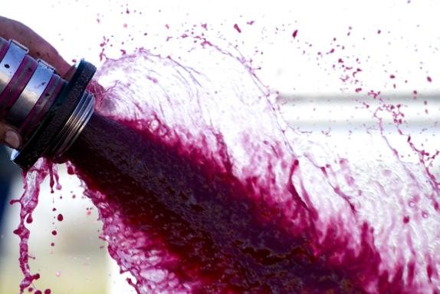
Stimulation of sluggish ferments
_{Controlled use of oxygen}
Oxygen content of juice at inoculation can vary
Degree of protection during preparation
Time between preparation and inoculation
Oxygen exposure during ferment
Fermentation type
Winery practices
Winery hardware

Slide 10
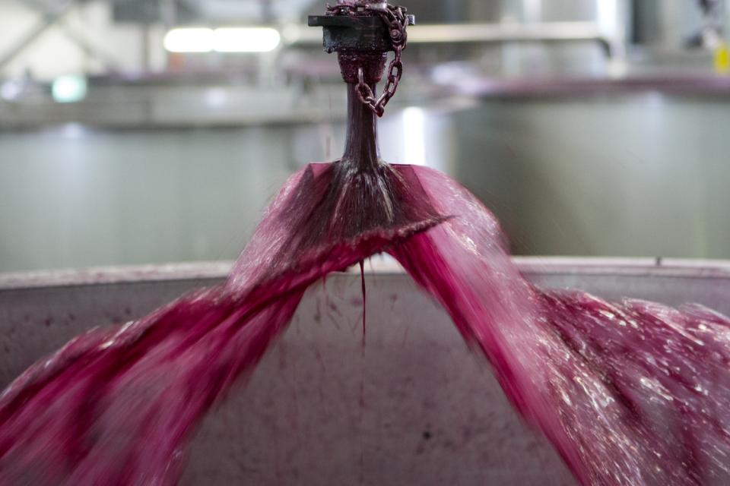
Impact of winery operations on dissolved oxygen in juice and fermenter
“Device” | DO before (% air sat) | DO steady state (% air sat)
Pump over |  | 1.5% | 10T fermenter
Pump over | 0.9% | 45% | At irrigator
Plunging |  | 2% | 10T fermenter
“Airdraw tube” (20 µm frit ) | 1.1 | 2.3 – 8.8 % | Inline
In-line spargers (~2 µm frit) | 1.0 | 21.5 % | Inline
Open tap on pump suction | 2.5% | 35.6 % | Inline - uninoc. juice
crack the fitting on pump inlet | 4.0 % | 37.3 % | Inline
Venturi | 0.9% | 42% | 110T SWAP fermenter
Notes:
If the irrigator is below the top of an open fermenter or is inside a closed top fermenter then oxygenation effect will be extremely curtailed.
We don’t always have the impact that we think we are having by doing the things that we do.
SWAP – sweeping arm fermenter

Slide 11
Effect of plunging and pump-over on ferment dissolved oxygen
10 ton open top fermenter
Irrigator head
5% air saturation = ~ 0.375 mg/L O₂

Slide 12
Rigorous exclusion of oxygen can cause stuck fermentations
Notes:
Even very small amounts of oxygen are sufficient to stimulate a dramatic improvement in fermentation performance.

Slide 13
Oxygen addition during fermentation can alter profile of fermentation volatiles
Notes:
Despite this, oxygenation of active fermentation is an effective way of alleviating reductive aromas especially in red wine fermentations

Slide 14
Diverse response by yeast to defined oxygen input
Reproduced from Julien et al (2000) 51:215-222

Slide 15
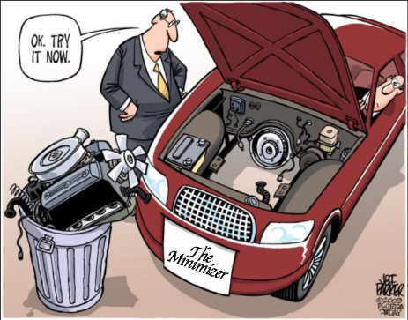
So...What’s under the Hood of a yeast?
And how do we start to understand it?
Notes:
Compare blueprints

Slide 16
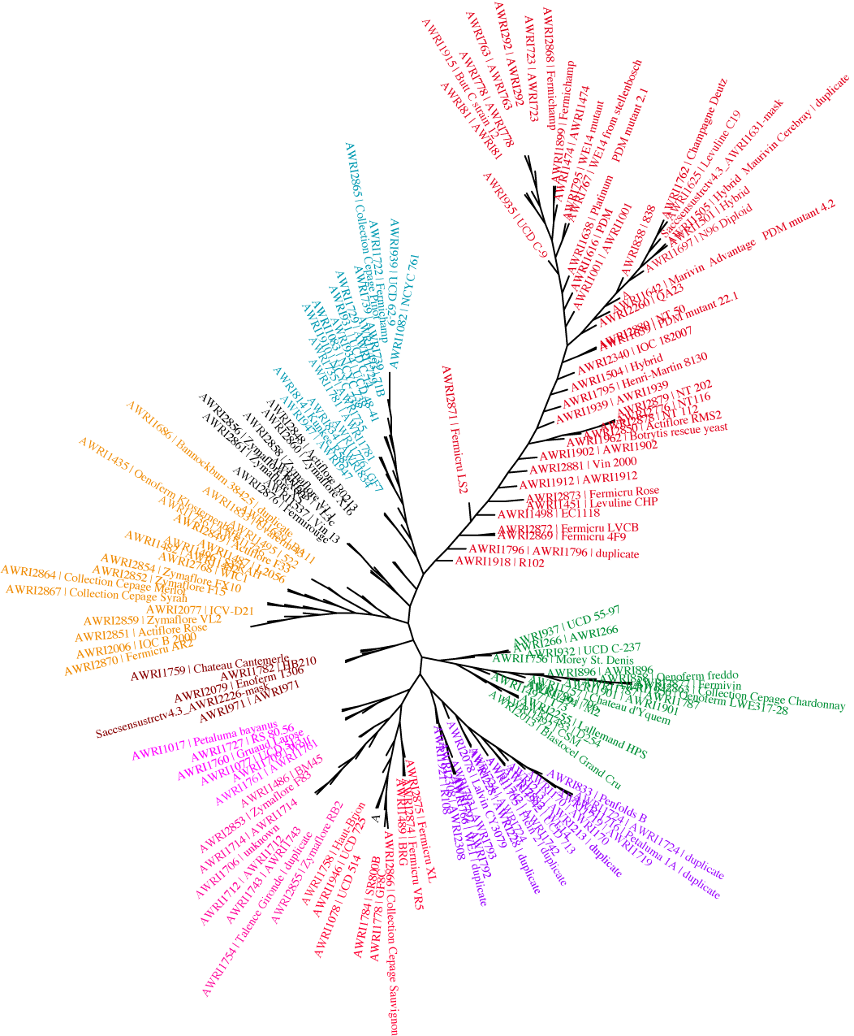
Using whole genome sequencing to explore wine yeast diversity
180 Unique wine strains sequenced
Strains from major yeast suppliers
50% of strains sequenced commercial
6 Major clades within the collection of sequenced wine yeast
Notes:
We can use this information, together with physiological characterisation, to map genetic features related to certain traits. – genome wide association mapping.
And there are now increasingly the tools available to do this.

Slide 17
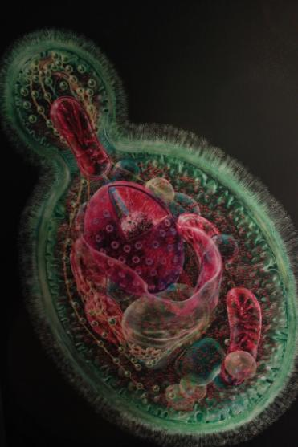
Where to from here?
Informed choice and application
Improved understanding of strain characteristics
Improved ferment management
Engineered solutions
Use of genetic markers for strain selection and development
Development of yeast with combinations of desirable properties
The challenge
To do this without the use of GM technology
Image by Col Ford
and Natasha de Vere

Slide 18
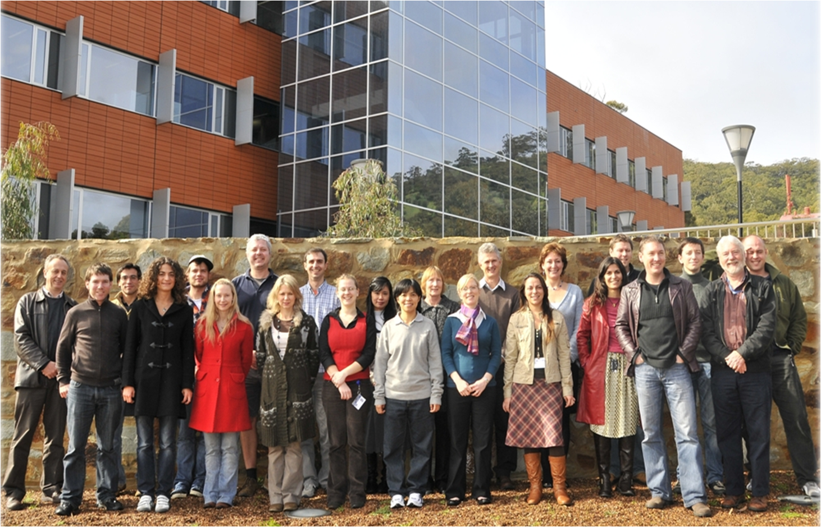
Acknowledgements
Radka Kolouchova
Angus Forgan
Anthony Borneman
Martin Day
Paul Henschke
Paul Chambers

